Slide 1


AWS Lambda
Serverless Computing in AWS
Cloud Architecture & DevOps | 2024-2025

Slide 2

Introduction to AWS Lambda
AWS Lambda is a serverless, event-driven compute service that lets you run code for virtually any type of application or backend service.
Runs code without managing or provisioning servers.
Scales automatically with application demand.
Ideal for event-driven modern architectures.
Built-in high availability and fault tolerance.

Slide 3




What is Serverless Computing?
No Infrastructure Management
Automatic Scaling
The system scales automatically by running code in parallel to handle precisely the number of incoming requests.
There is no need to provision, patch, or maintain servers. AWS handles the entire underlying infrastructure for you.
Pay-for-Value
Event-Driven Nature
You never pay for idle time. You are only charged when your code is running, measured in milliseconds.
Resources are consumed only when triggered by specific events like file uploads or database updates.

Slide 4
Traditional vs. Serverless
Feature | Traditional Architecture | Serverless (Lambda)
Management | Requires manual server patching/OS updates | Zero maintenance; fully managed by AWS
Scaling | Manual or rule-based auto-scaling | Instant, transparent automatic scaling
Cost | Pay for uptime (fixed monthly costs) | Pay only for execution (variable)
Maintenance | High operational overhead | Focus entirely on application logic

Slide 5






Key Features of AWS Lambda
Fully Managed
Auto Scaling
Event Driven
Pay-Per-Use
Scales from 1 to thousands of requests instantly.
Responds to triggers from other AWS services.
Sub-second metering based on execution time.
No operating system or server hardware to worry about.

Slide 6



How AWS Lambda Works
1. Write Code
2. Configure Trigger
3. Execution
4. Cleanup
Upload your code to Lambda as a ZIP or Image.
Lambda spins up environment and runs code.
Result returned; environment is reclaimed.
Set up an event (like an S3 upload).

Slide 7
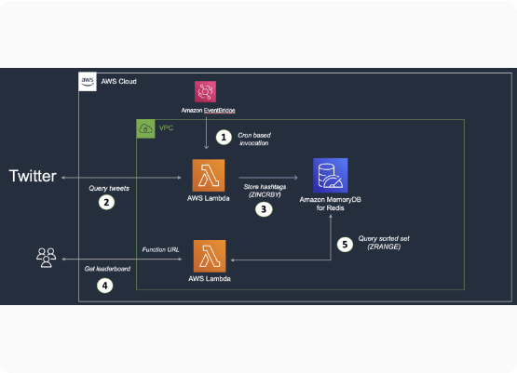
AWS Lambda Architecture
Event Source: The external trigger (S3, API GW).
Function: The logic processing the input event.
Env: Isolated compute workspace (Firecracker).
Output: The result sent back or saved.

Slide 8

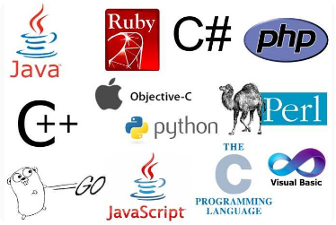

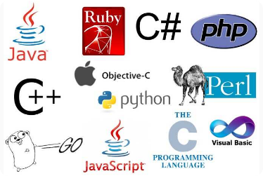

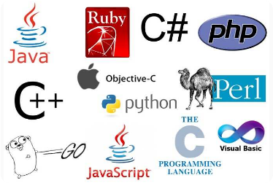
Supported Programming Languages
Python & Node.js
Java & .NET
Go & Ruby
*Custom runtimes (Rust, PHP, etc.) are supported via the Lambda Runtime API.

Slide 9
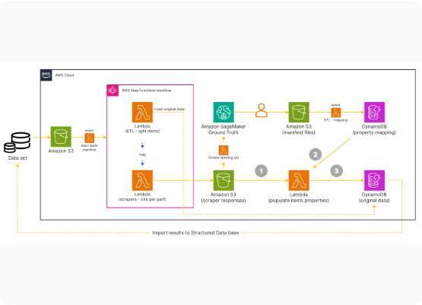
AWS Lambda Event Sources
Amazon S3: File uploads, deletions, and metadata updates.
API Gateway: HTTP requests and REST/WebSocket APIs.
DynamoDB: Changes in database records (Streams).
SNS/SQS: Messaging and queue-based async processing.

Slide 10






Service Integration Ecosystem
File Analysis
Mobile Backend
Monitoring
Process S3 logs or images automatically on upload.
Power REST APIs via Amazon API Gateway.
Send logs and custom metrics to CloudWatch.

Slide 11

Core Function Components
Function Code
Runtime
The business logic you provide, along with any external libraries or dependencies required.
The execution environment (e.g. Python 3.12) that runs your code inside the container.
Memory Config
Timeout Limit
Scales from 128 MB to 10 GB. More memory allocates more CPU power to the function.
The maximum time your code can run. Configurable from 1 second up to 15 minutes.

Slide 12
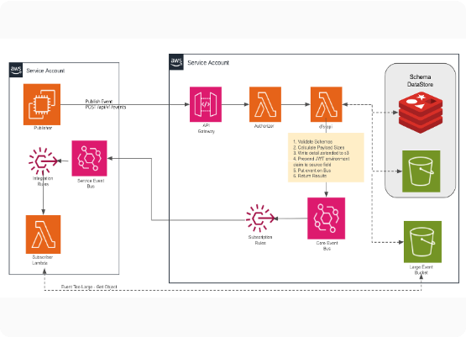
Execution Model Lifecycle
Lifecycle Steps
When an event occurs, Lambda finds or initializes an execution environment.
Init: Environment setup (Cold Start).
Invoke: Logic executes on event data.
Shutdown: Releasing resources after idle time.

Slide 13
Advantages of AWS Lambda
Zero Admin: Total focus on product code, not patching or OS management.
Hyperscale: Effortlessly handles sudden spikes in traffic without manual capacity planning.
Cost Effective: Sub-second billing ensures you pay only for exactly what you use.
Security: Isolated execution environments and fine-grained IAM permissions for every function.

Slide 14

Limitations & Challenges
Execution Time
Cold Starts
Maximum timeout of 15 minutes makes it unsuitable for long-running batch processes or complex deep learning training.
The initial invocation latency when the environment is created can impact real-time latency-sensitive applications.
Local Storage
Environment Control
Limited ephemeral storage (/tmp) of up to 10 GB, which is erased after the execution environment is destroyed.
Limited control over the underlying operating system and specific hardware configurations compared to EC2.

Slide 15
AWS Lambda Pricing Model
1 Million
Free Requests per Month
Pricing is based on two primary factors: Requests and Duration (Execution Time).
Requests: $0.20 per million requests.
Duration: Cost per GB-second of compute.

Slide 16
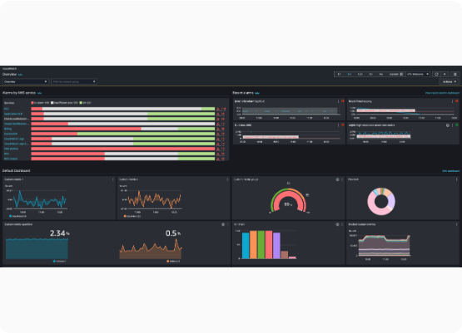
Monitoring & Observability
Key Tools
CloudWatch Logs: Automatic standard output log capture.
CloudWatch Metrics: Track Errors, Duration, and Success.
AWS X-Ray: End-to-end tracing for distributed apps.

Slide 17



Security Best Practices
IAM Roles
Encryption
VPC Integration
Use Least Privilege Principle for every function.
Encrypt environment variables at rest using KMS.
Connect to private resources like RDS or ElastiCache.

Slide 18

Real-World Use Case
Image Processing Pipeline
A classic serverless architecture where users upload high-resolution images to S3, triggering an automated workflow.
Trigger: New file uploaded to S3.
Action: Lambda resizes the image.
Result: Thumbnails saved to a second bucket.
Impact: Massive scale without server overhead.

Slide 19
Summary of Best Practices
One Function, One Task: Keep functions small, modular, and focused.
Optimize Memory: Right-size memory to balance cost and speed.
Dependency Management: Use Lambda Layers for shared code and libraries.
Cold Start Tuning: Minimize initialization code and use Provisioned Concurrency.
Error Handling: Implement dead-letter queues (DLQ) for failed events.

Slide 20

Conclusion
AWS Lambda simplifies application development and enables high-performance, event-driven architectures at scale.
Thank you for your attention! Questions?

Slide 21






Image Sources
https://upload.wikimedia.org/wikipedia/commons/thumb/5/5c/Amazon_Lambda_architecture_logo.svg/250px-Amazon_Lambda_architecture_logo.svg.png
Source: en.wikipedia.org
https://www.kofi-group.com/wp-content/uploads/2021/03/shutterstock_1609164064-scaled-1.jpg
Source: www.kofi-group.com
https://miro.medium.com/0*Z2CIpyONVOd0BGkl.png
Source: itnext.io
https://contentstatic.techgig.com/photo/67337479.cms
Source: content.techgig.com
https://images.ctfassets.net/w6r2i5d8q73s/1mdrT2mU09TpfTPZSEr9v2/585f7580282ed25b57d015c9a10ffa18/4.png?fm=webp&q=75
Source: miro.com
https://miro.medium.com/1*Uu8iAjeWqmCP0nhrf5KG9w.png
Source: aws.plainenglish.io

Slide 22


Image Sources
https://docs.aws.amazon.com/images/AmazonCloudWatch/latest/monitoring/images/CW-default-dashboard-update.png
Source: docs.aws.amazon.com
https://lumenci.com/wp-content/uploads/2024/03/Digital-Image-Processing-Banner-1024x576.webp
Source: lumenci.com

